Slide 1
Design and production of a neopixel PCB board programmable in Arduino, Micropython and Microbit for Valentine's Day
Animations techniques
Laurent Strodiot – Coach at CoderDojo – Fernelmont
24th February, 2024

Slide 2
Disclaimer
I am a hobbyist, not a professional.
All documents, elements presented during the session are from my own experience or copied from others, found on internet or during discussions with other passionated peoples and should be considered as shareable.
I am not responsible or would take no accountabilities for any damages you may experience using the presented or derived material
I am here to have fun and share my limited knowledge with you, have fun !

Slide 3
Agenda
Introduction & Idea
Electronic circuit
Selection of components
Use of EasyEDA
Electronic schematic
Convert schematic to PCB
PCB production
Use of specific manufacturers
PCB finalization
Potential improvements
Micropython example
Arduino example
Micro-bit example
Go further with ideas
References

Slide 4
1. Idea
Let’s create a pulsative heart to show my love !!!!
With neopixels – it must shines and attracts attention !
Maybe a button to interact with the heart ?
I could create a customed made PCB
On a 3D printed stand
Power supplied by a battery (18650) – other (USB, etc)
That I could code in arduino or Micropython or connect to Microbit

Slide 5
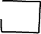
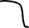

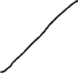

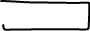
1. Idea
External CTRL connector
Button
Screw to attach
Led (18)
PCB card
3D printed support
Batteries (18650)

Slide 6
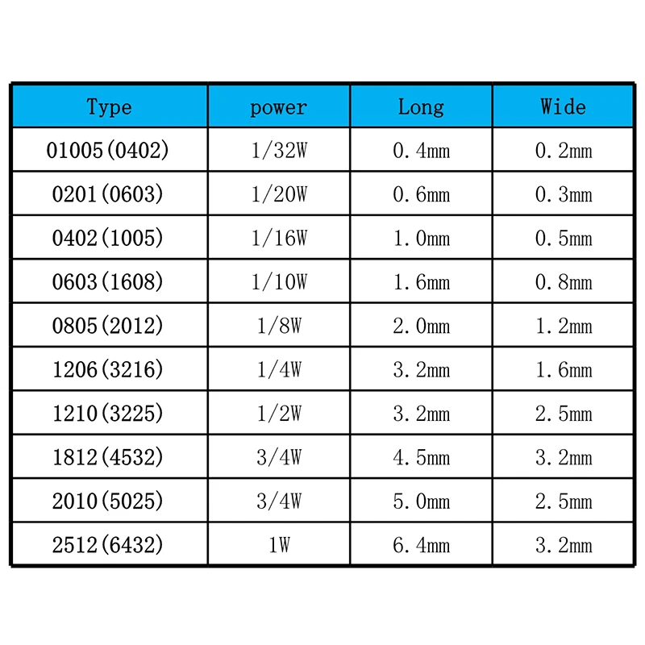
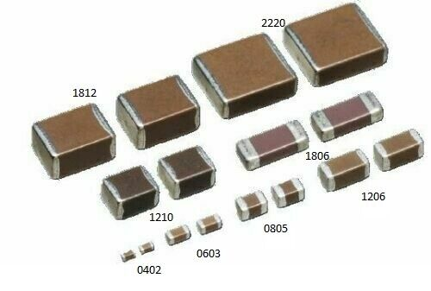
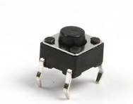
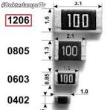
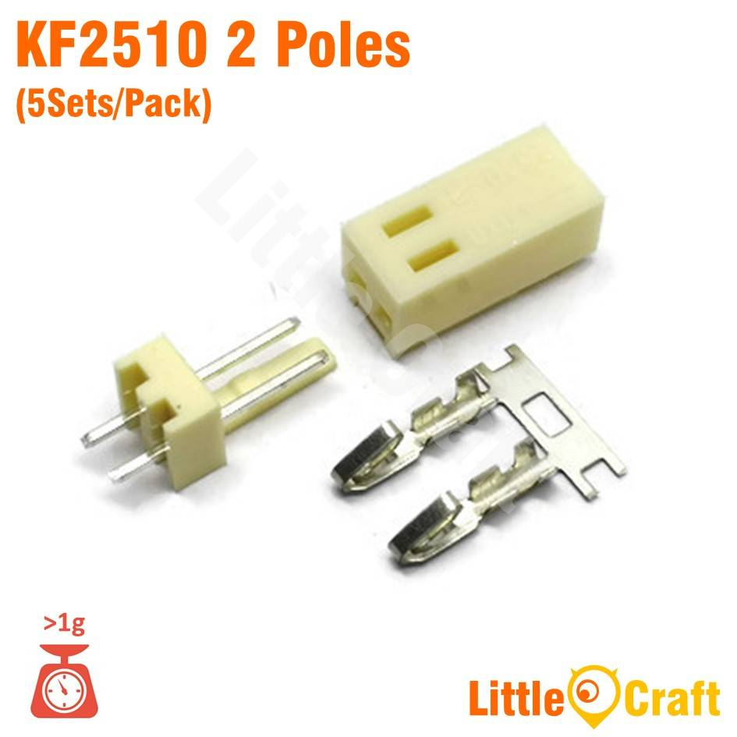
2 Electronic circuit – choice of components
Neopixel on a PCB board : WS2812b
Decoupling capacitors (0.1 – 1 uF) – (SMD 603)
Resistor – 220 - 470 ohm (SMD 1206 – 3216 metric)
KF2510 connectors (to connect the battery or external CTRL)
Button (4 pins) & jumpers
Microcontroller : ESP32 C3 super mini

Slide 7
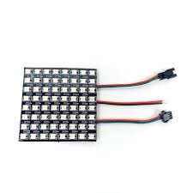
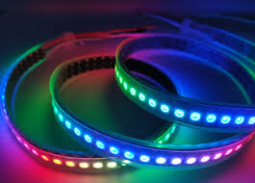
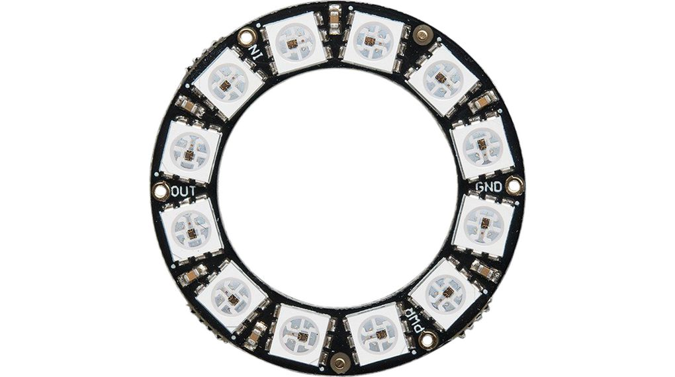
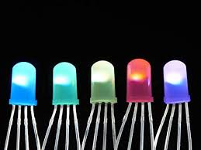
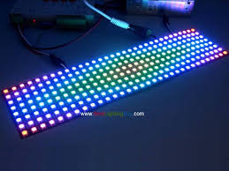
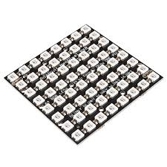
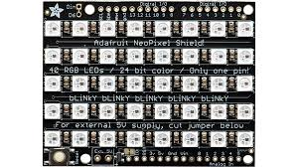
2 - Electronic circuit – choice of components

Slide 8
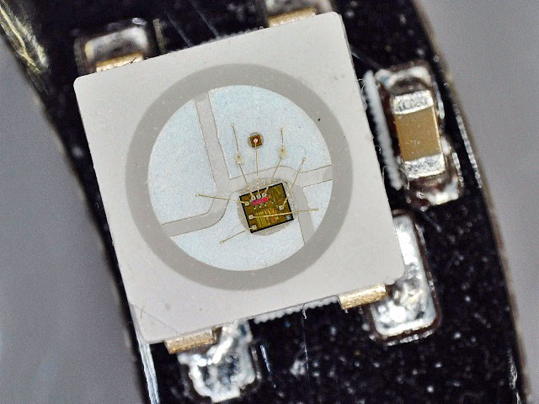
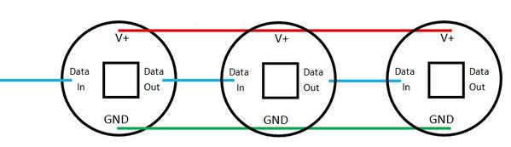
2 Electronic circuit – choice of components
Neopixel (WS2812b)
Power supply : 5V but can work with lower voltage (3V)
Attention : current can be high 20 mA / color – R-G B
Max 60 mA per pixel

Slide 9
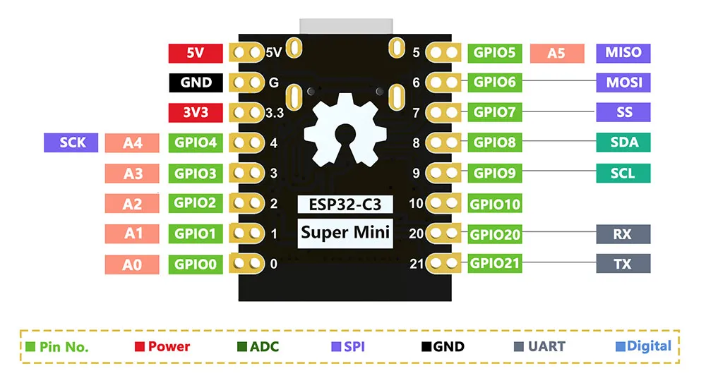
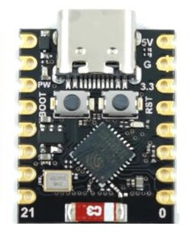
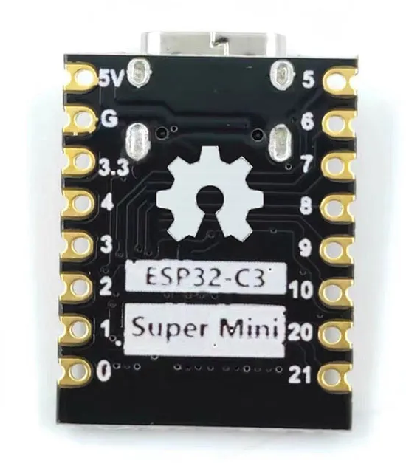
2. Micro-controller (ESP32 C3 super mini)
Power supply: 3.3-6V → cool : can use batteries
ESP32-C3, 32 bits RISC-V one core, up to 160 MHz
4 MB flash (Micropython 128ko)
400 Ko SRAM (+++)
11 GPIO (3.3v)
1xI2C, 1xSPI, 2xUART, 11xGPIO(PWM), 4xADC
Wifi: 802.11b/g/n, 2.4GhHz, Bluetooth 5.0
Compatible with SMD
Cost : 2.5 €

Slide 10
2.Electronic circuit & PCB design softwares
EasyEDA
KiCad
Altium
Eagle
…
I choose EasyEDA :
web application /
can be downloaded /
Lots of tuto on youtube

Slide 11
2. PCB Conception
1 Electronic circuit design
Draw on paper your circuit
Pick the components from library and put them in the circuit
Make the connections
Check and recheck, also check again !!!
2 convert to PCB
Draw the board outlines (simple board 2 layers → multilayers)
Place the components on the PCB : order !!!
Route the components (attention to width based on current)
Recheck the circuit and PCB
Print a PDF and check the component footprints

Slide 13
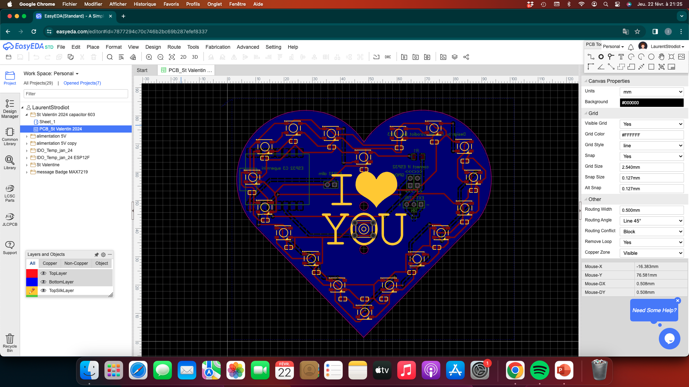

Slide 14
3 PCB production
Many manufacturers for makers and their small prototypes
JLCPCB
PCBway
NextPCB
AllPCB
…
Elektor (EU) but €€€
You need :
Gerber file - minimum
BOM file
Pick and place file

Slide 15
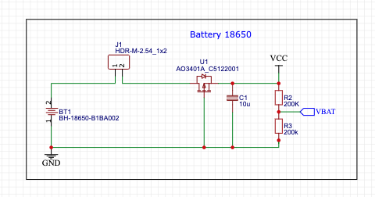
3. PCB production
Potential improvments
Polarity protection (use of p-MOSFET)
Use of microcontroler modules (ESP8266, ESP32 C3) → need supply but you reduce the total cost (current PCB cost +/- 15 €/each)
Other input ? Microphone ? LDR ?

Slide 16
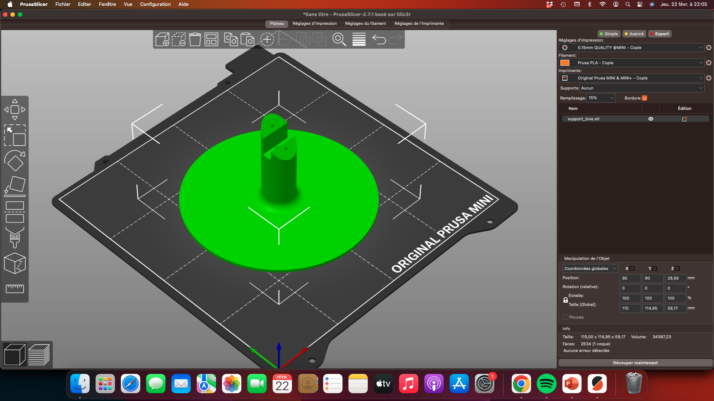

Slide 17
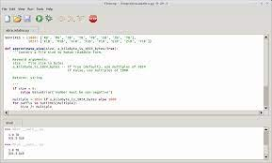
4. Neopixel modules in Micropython + first examples
Use of Thonny (IDE) script editor and REPL (free)
Micropython (https://micropython.org/download/)
New: Flash directly from Thonny the firmware
1) Import libraries:
From Machine import Pin (to use the pins)
From neopixel import NeoPixel (to use the neopixels)
From time import sleep (have some pause)
2) Create the neopixel object:
np = NeoPixel(Pin(4), 18) (create np object connected to GPIO 04 with 64 leds)
3) Each led can be addressed : np[0] = ( r, g, b) = (0-255, 0-255, 0-255)
Example : np[3] = (127,0,0) – set the pixel with index 3 to red (mid intensity)
4) Display the color : np.write() – call the function write of the object to display the color on the led index 3

Slide 18
4. Code in Micropython (beating heart)
while True:
for i in range(0,50):
a,b,c=color[select]
np.fill((int((a*i)/50),int((b*i)/50),int((c*i)/50)))
np.write()
for i in range(50,0,-1):
a,b,c=color[select]
np.fill((int((a*i)/50),int((b*i)/50),int((c*i)/50)))
np.write()
for i in range(0,50):
a,b,c=color[select]
np.fill((int((a*i)/50),int((b*i)/50),int((c*i)/50)))
np.write()
for i in range(50,0,-1):
a,b,c=color[select]
np.fill((int((a*i)/50),int((b*i)/50),int((c*i)/50)))
np.write()
sleep(0.02)
from machine import Pin
from neopixel import NeoPixel
from time import sleep
color=[(50,0,0),(0,50,0),(0,0,50)]
select = 0
np = NeoPixel(Pin(4), 18) # NeoPixel( broche_signal, nbre_de_led )
def button_Pressed(change):
global select
select +=1
if select>2:
select=0
button = Pin(2, Pin.IN, Pin.PULL_UP)
button.irq(handler=button_Pressed, trigger=Pin.IRQ_FALLING)

Slide 19
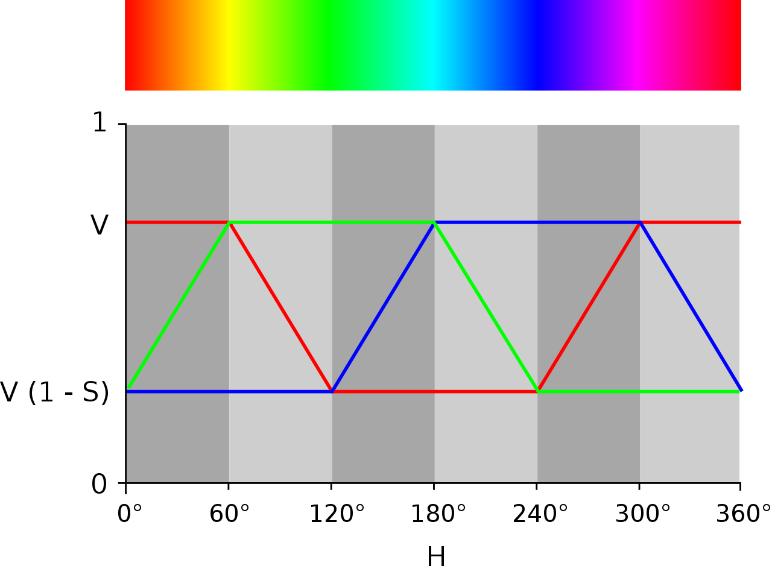
4. Code in Micropython (Rainbow)
import neopixel
from machine import Pin
from time import sleep
PixNum = 18
PixPin = 4
speed = 5
np=neopixel.NeoPixel(Pin(PixPin), PixNum)
def getRGB(deg): # translate HSV to RGB value (see https://www.youtube.com/watch?v=Qmm_sxpYIEc)
m=1/60
if deg>=0 and deg<60:
R=1
G=0
B=m*deg
if deg>=60 and deg<120:
R=1-m*(deg-60)
G=0
B=1
if deg>=120 and deg<180:
R=0
G=m*(deg-120)
B=1
if deg>=180 and deg<240:
R=0
G=1
B=1-m*(deg-180)
if deg>=240 and deg<300:
R=m*(deg-240)
G=1
B=0
if deg>=300 and deg<360:
R=1
G=1-m*(deg-300)
B=0
myColor=(int(R*50),int(G*50),int(B*50))
return myColor
1
0
0 60 120 180 240 300 360°

Slide 20
4. Code in Micropython (Rainbow)
while True:
for deg in range(0,360,speed): # to go around the HSV color wheel (0-360 deg)
for j in range(0,18,1): # to put the rainbow across the 18 pixels on the PCB
value = deg+j*20 # each pixel is separted by 360/18 = 20 degrees
if value>=360: # if the value is above the max of 360 degrees, you come back to start
value=value-360
color=getRGB(value) # call the function to convert HSV degree to RGB values (R, G, B)
np[j]=color # assign the color to the pixel
np.write() # push the buffer to the real pixels
sleep(0.01) # wait 10 ms before moving to the next step

Slide 21
5. Let’s code in arduino (in IDE)
void loop() {
for (int i=0;i<75; i++){
FastLED.setBrightness(i);
FastLED.show();
//delay(10);
}
for (int i=75;i>0; i--){
FastLED.setBrightness(i);
FastLED.show();
//delay(10);
}
for (int i=0;i<75; i++){
FastLED.setBrightness(i);
FastLED.show();
//delay(10);
}
for (int i=75;i>0; i--){
FastLED.setBrightness(i);
FastLED.show();
delay(10);
}
}
#include <FastLED.h>
#define NUM_LEDS 18
#define LEDPIN 4 // GPIO4 on the ESP32 C3
CRGB leds[NUM_LEDS];
void setup() {
FastLED.addLeds<NEOPIXEL, LEDPIN>(leds, NUM_LEDS);
for (int i=0;i<NUM_LEDS; i++){
leds[i] = CRGB (255,0,0);
}
}

Slide 22
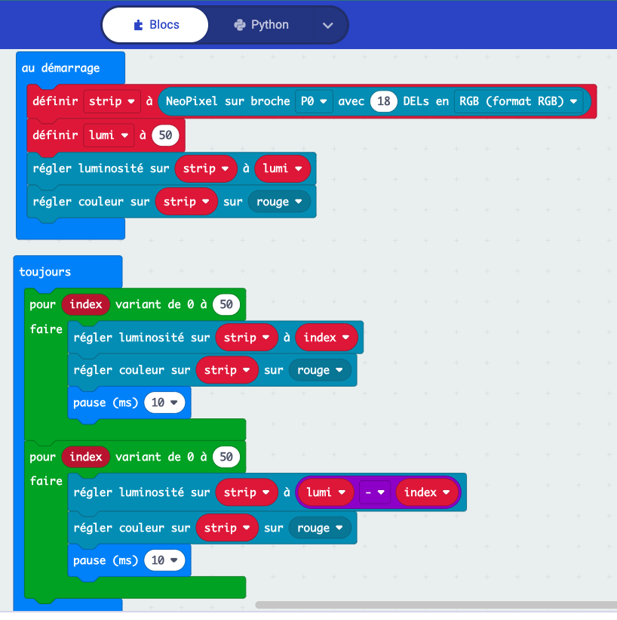
6. Let’s code in microbit
Use external control connector
Use neopixel module in Microbit.org

Slide 23
7 Run the Demo !!! Have fun !!!
Q&A
Possible optimization ?
Other ideas ? Christmas Tree, stars, disco disk, etc
Use your imagination and the one of the ninja !!!

Slide 24
8. References
https://docs.micropython.org/
https://thonny.org/
https://shop.mchobby.be/fr/
https://www.raspberrypi.com/products/raspberry-pi-pico/
https://shop.pimoroni.com/
https://www.elektor.fr/
https://bhave.sh/
Many, many, many more on internet, youtube, etc

Slide 25
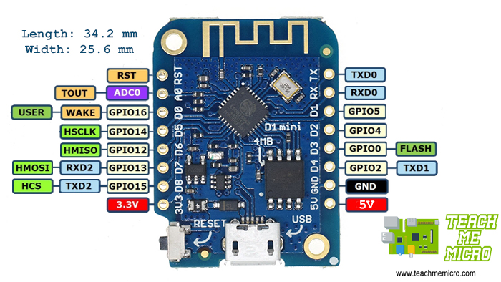
2. Micro-controller (ESP8266)
80/160 MHZ
4 MB flash ( Micropython)
64 ko SRAM
11 GPIO
1 ADC (3.3v)
Wifi connection
PWM on all GPIO (except D0)
1 SPI (mat), I2C(soft)
Need CH340 pilot communication

Slide 26
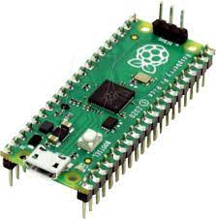
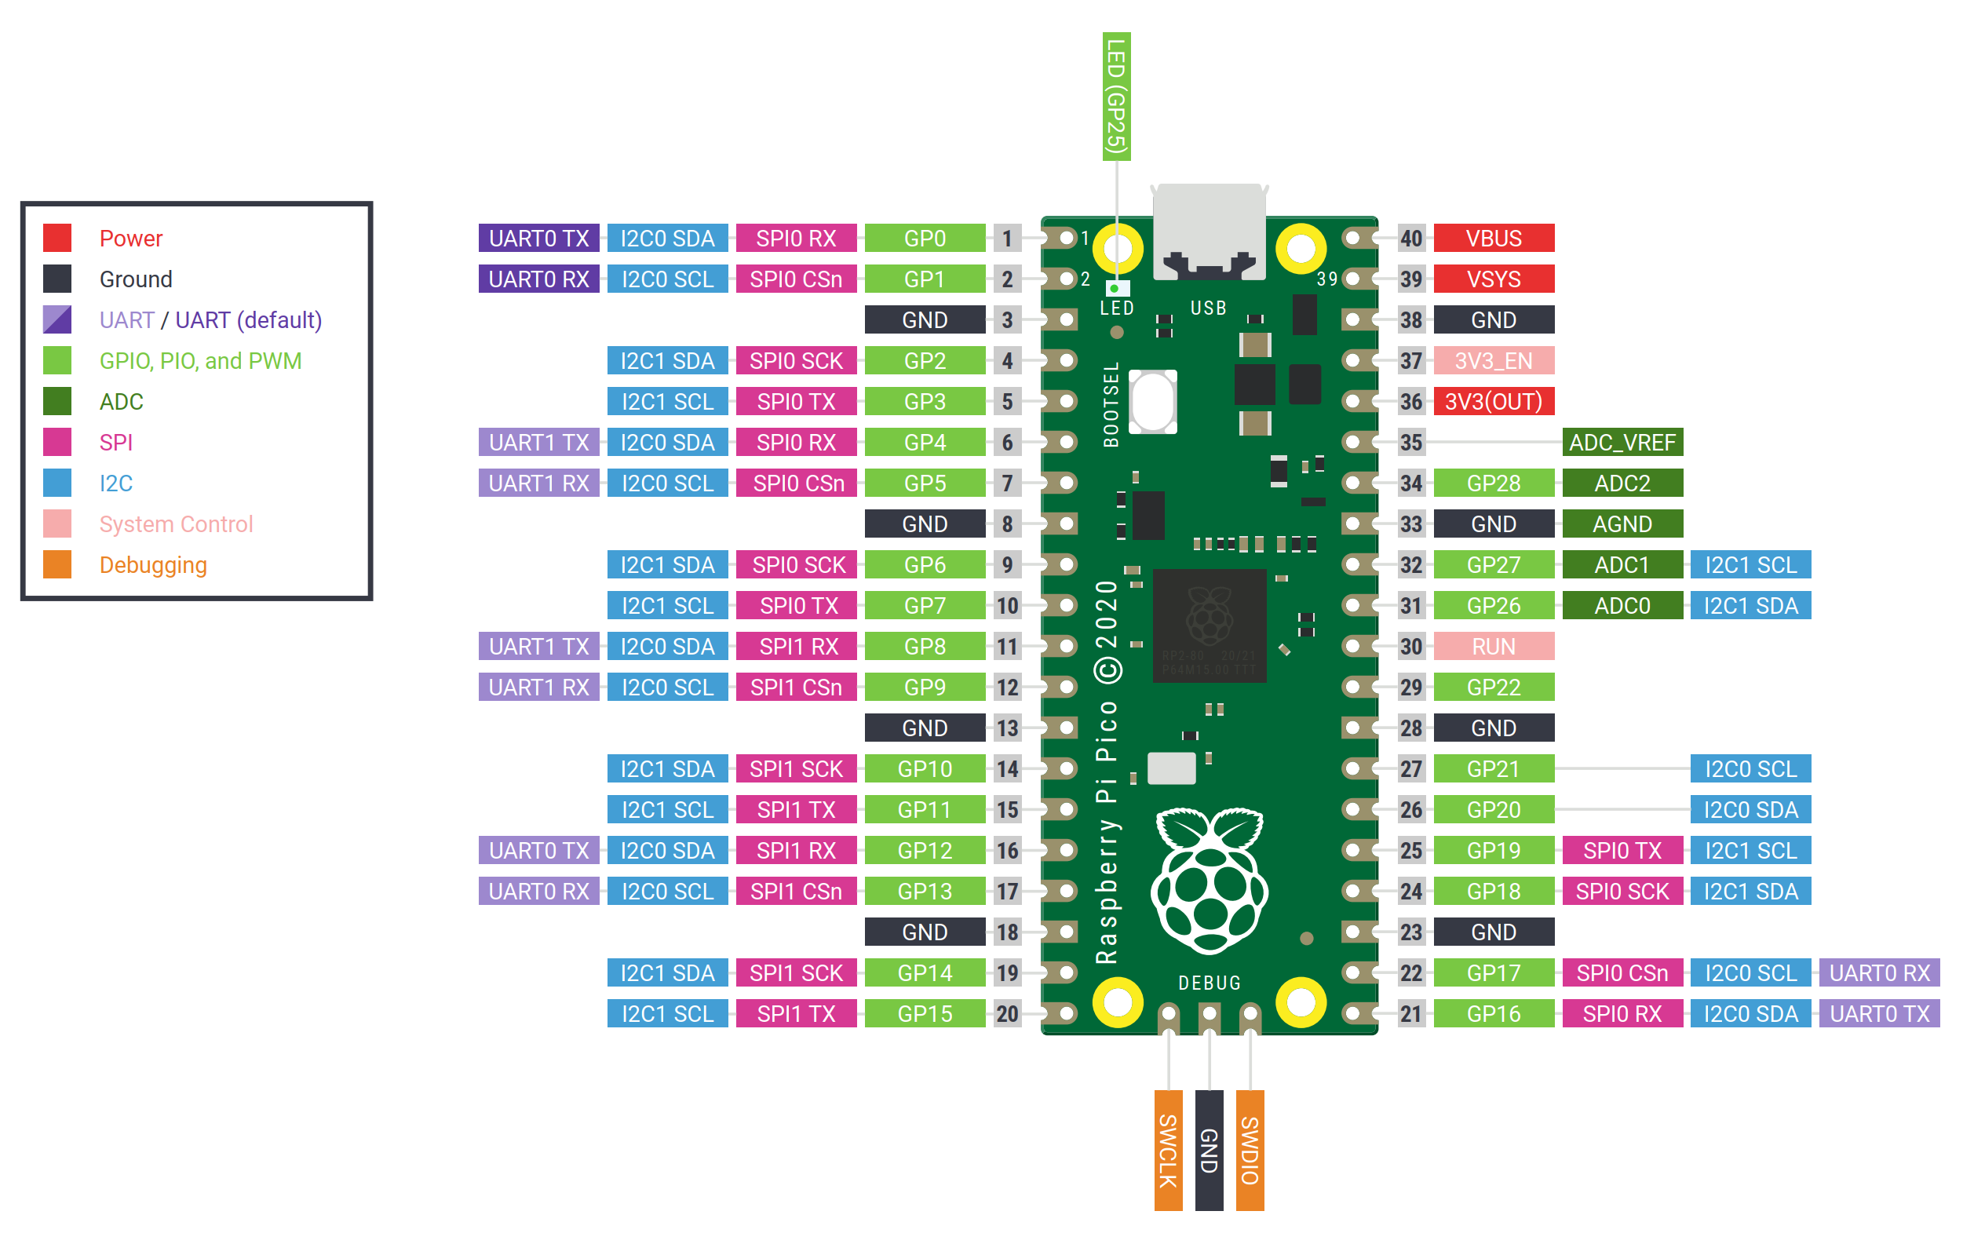
2. Micro-controller (Raspberry Pi Pico)
RP2040 @133 MHZ (2 cores)
2 MB flash (Micropython 128ko)
265 Ko SRAM (+++)
30 GPIO (3.3v)
6 ADC 12bits
16 PWM
2x UART, 2x I2C, 2x SPI

Slide 27
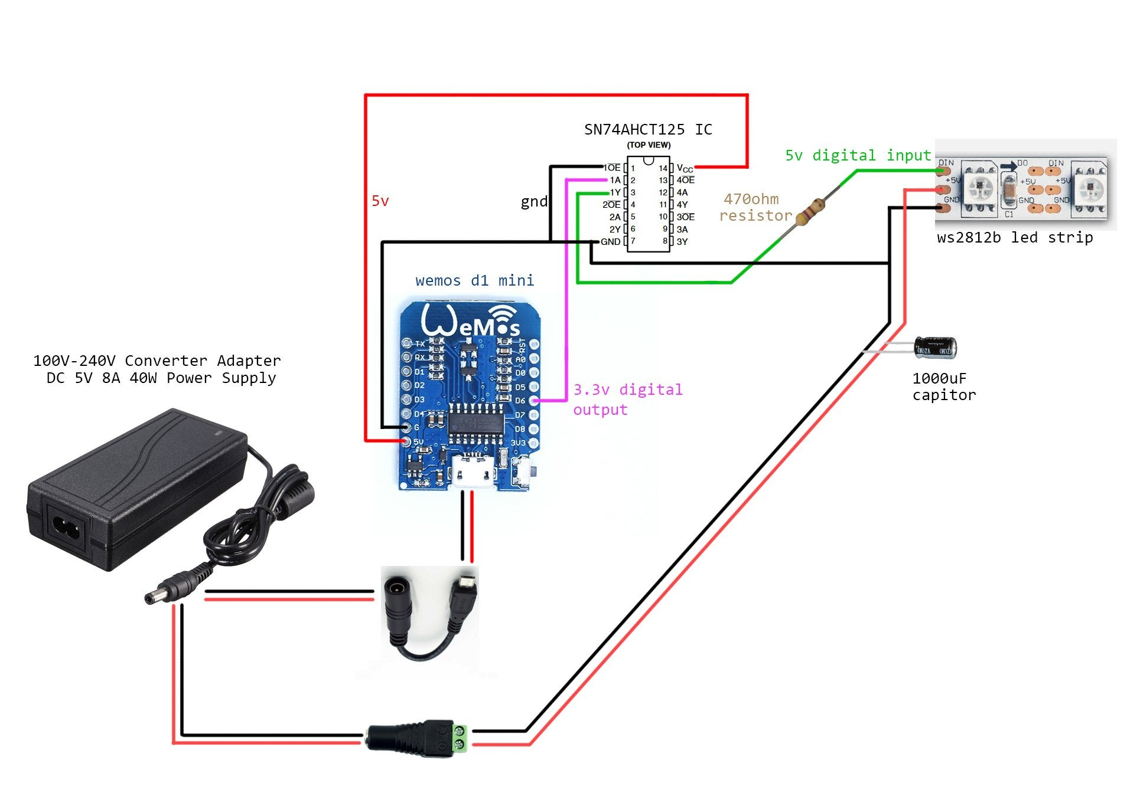
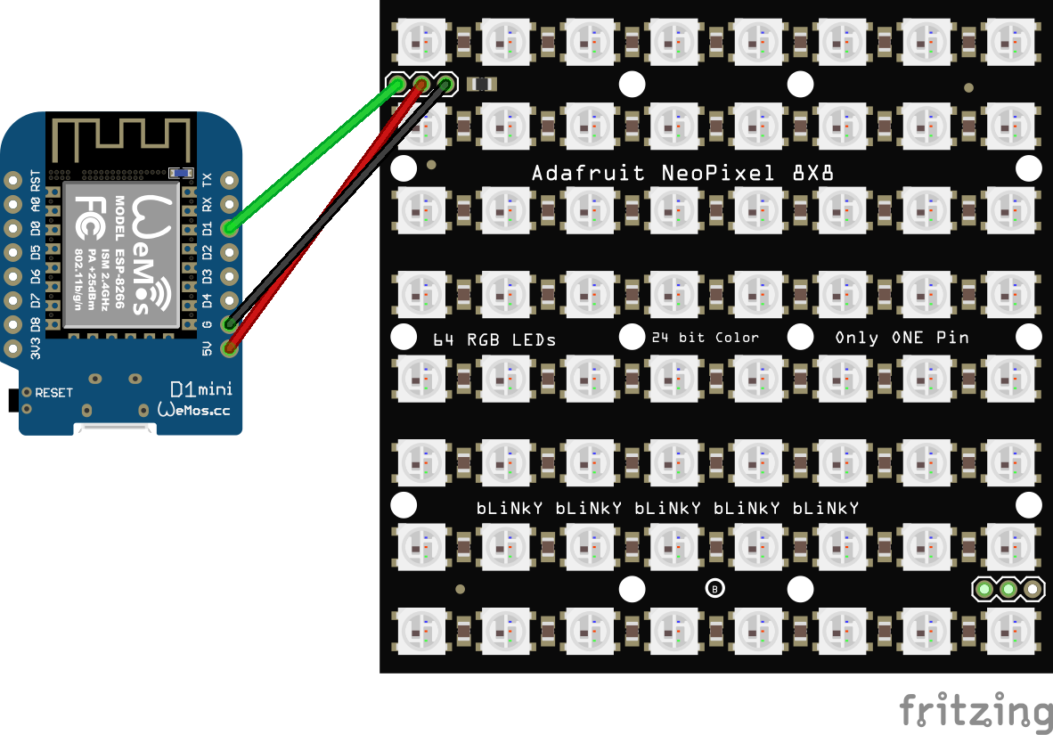
Wiring Wemos to Neopixels
Current consumption : max 20 mA by led (x3 : Red, Green, Blue) : 60 mA in full brightness

